Slide 1
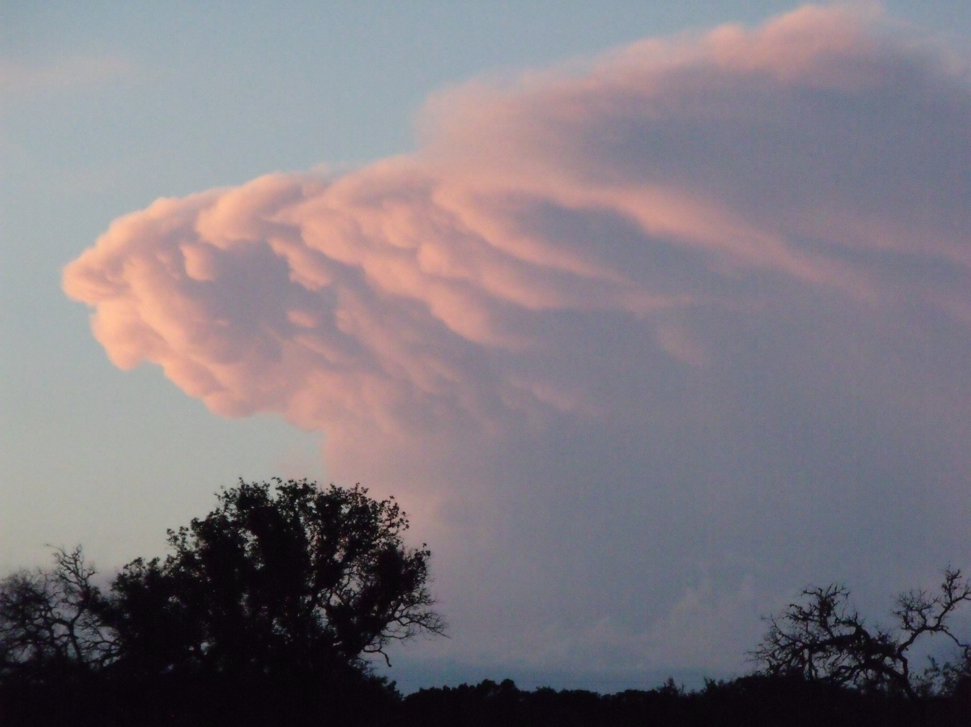
Creating Advocates for Nature Through Meaningful, Engaging Interpretation
Presented by Craig Hensley, TNT Biologist
“Interpretation should instill in people the ability, and the desire, to sense the beauty in their surroundings – to provide spiritual uplift and to encourage resource preservation.”
-Beck and Cable
Notes:
For the majority of my career, I have been involved in this thing called interpretation, even though I have never thought of myself as an interpreter -- educator, naturalist, yes, but interpreter, I am still a work in progress. Over the course of those years, I have had the pleasure to share the natural world with more than a million people from Minnesota to Texas and points in-between. When I got my start in “nature education” as I viewed it, I had no real idea what interpretation was – I don’t remember but I don’t think I had even heard the word. Today when I think of interpretation, I still wrestle with what it exactly is. I have read the textbooks, research and the rest, and yet questions remain in this brain of mine. I am still learning. Today’s presentation will not be a treatise on interpretive dogma with lots of charts, statistics, and the like. Instead, I am delighted to speak with you today about interpretation from an on-the-ground, experienced-based view. I will talk about the varieties of interpretation out there that you have all encountered. I will share with you what successful interpretation looks like and what you, as an interpreter, should come to understand so that your interpretive experiences are the best you can make them. I also hope to share with you a number of those things that make for a great interpreter knowing that we are all different in our skills and who we are. And finally, I will close with what I, based on my experiences, find to be key factors to good interpretation – and how I have learned to determine if I was successful. All of you as Master Naturalists can have a great influence on your communities through education and interpretation. How much and how successful that influence is comes down to your passion, for the resource, for the audience, and most importantly, your desire to want to share. As I will emphasize throughout, passion, and dare I say, love, I believe, is key.
Today, my colleague, Tania Homayoun, will be keeping an eye on the chat, including sharing feedback from you from a few questions I will pose. My goal is to wrap this up in time for us to visit. To begin, here’s my first question: Does your chapter train new classes specifically on Chapter 23: Volunteers as Teachers during initial training? Let us know with a simple yes or no. We will discuss at the end of the presentation.

Slide 2
Traditional Approaches to Teaching About the Natural World
Get them outside so we can check that box
Fill them with facts – data dumping
Nature consumption vs. nature appreciation
One and done approach to nature experiences

Slide 3
Changing Our Approach
Building appreciation of and for the natural world through multiple, first-hand experiences
Using hands-on and hands-in exploration to develop critical thinking skills
Creating life-long learners and advocates who understand that our fate is directly related to how we treat the natural world
Incorporating the principles of interpretation

Slide 4
So, what is…
INTERPRETATION?
At its best, interpretation:
connects the person emotionally to that which is being interpreted…
uses those emotional connections to create caring for what is being interpreted…
through caring, creates an advocate for what is being interpreted

Slide 5
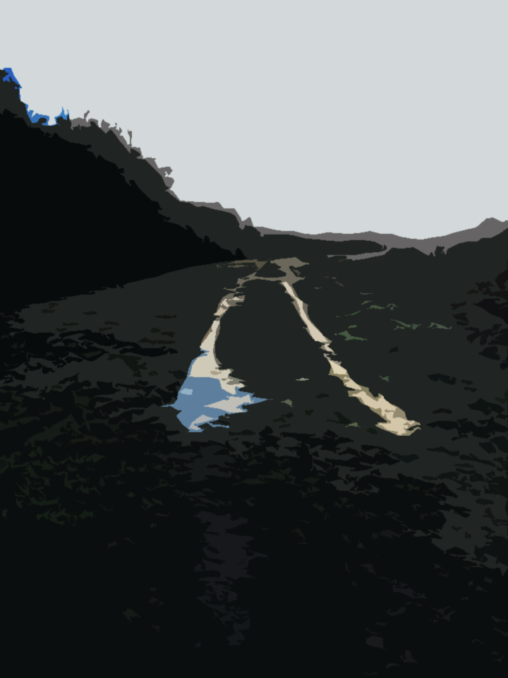
Interpretation invites us on a path to explore the world we know but may not know about; it helps us remove our blinders and, in a sense, discover ourselves as we discover the wonders around us.
I am an Old Time Country Lane
Now I have been
Officially Vacated and Closed
(I never liked automobiles anyway)
I invite you to walk – as folks
have walked for generations
and be friendly with my trees
my flowers and my wild creatures
Bob Mann, Forest Preserve District of Cook County, Illinois
Notes:
Interpretation is delivered in many ways; let’s take a look at different ways to accomplish this, beginning with this wonderful bit of writing.

Slide 6
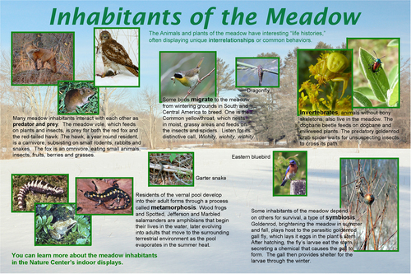
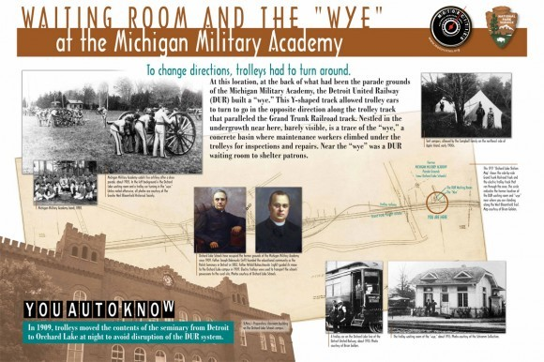
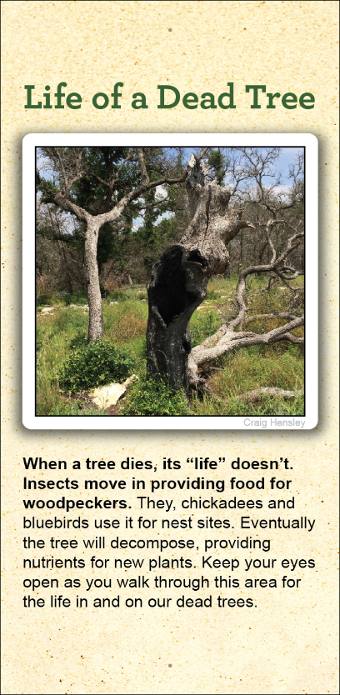
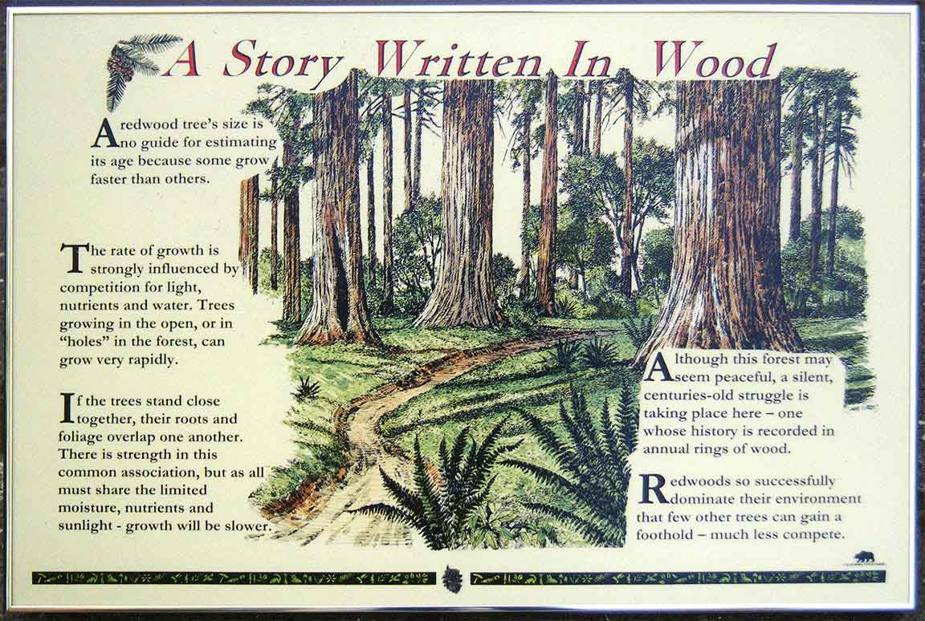
Static
Interpretation:
Panels/Signs
Notes:
Interpretation comes in many forms – non-personal and personal – including…

Slide 7
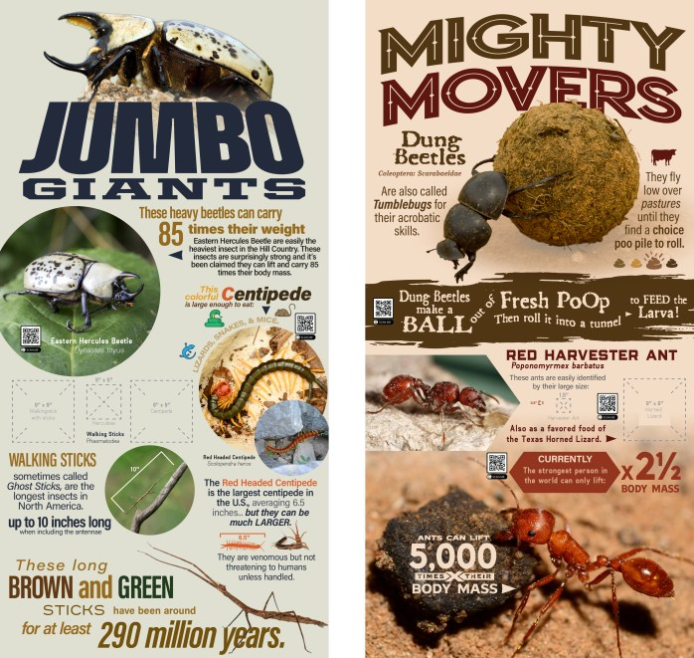
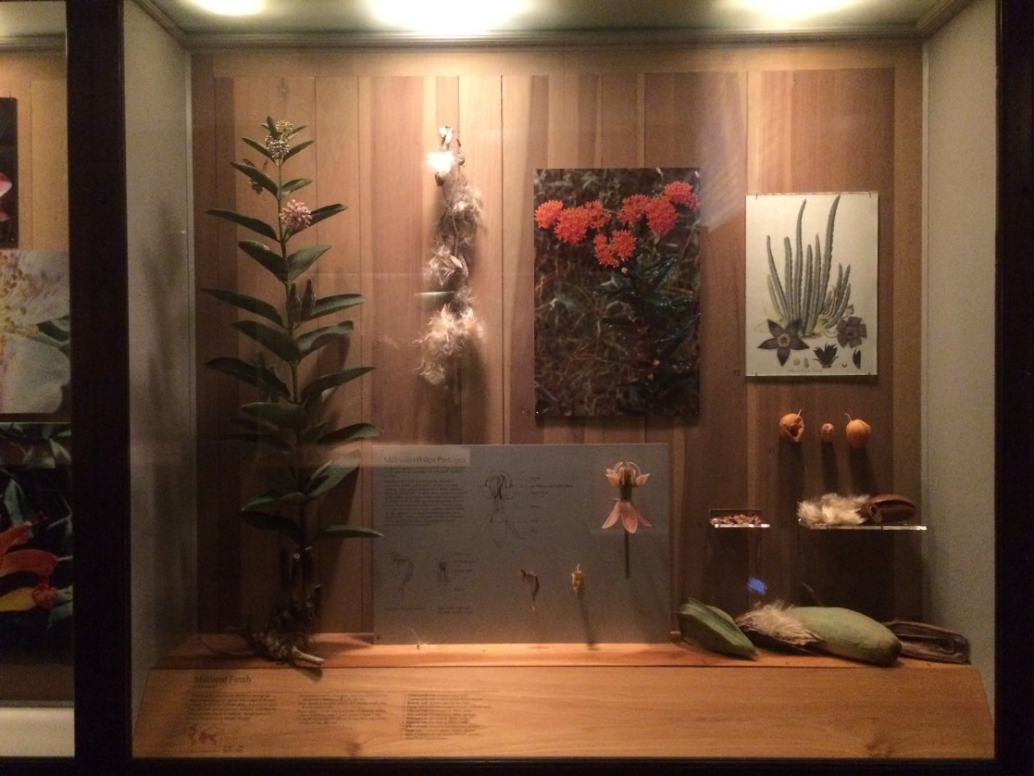
Static Interpretation:
Exhibits

Slide 8
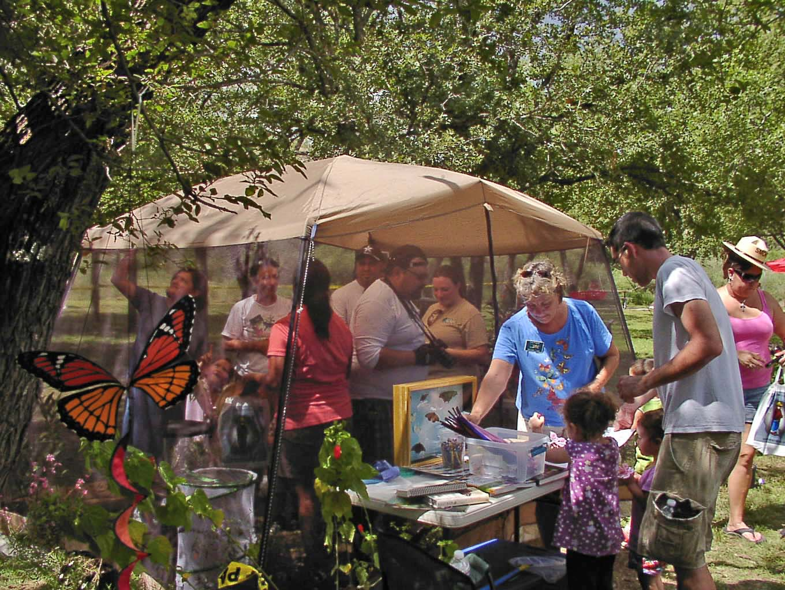
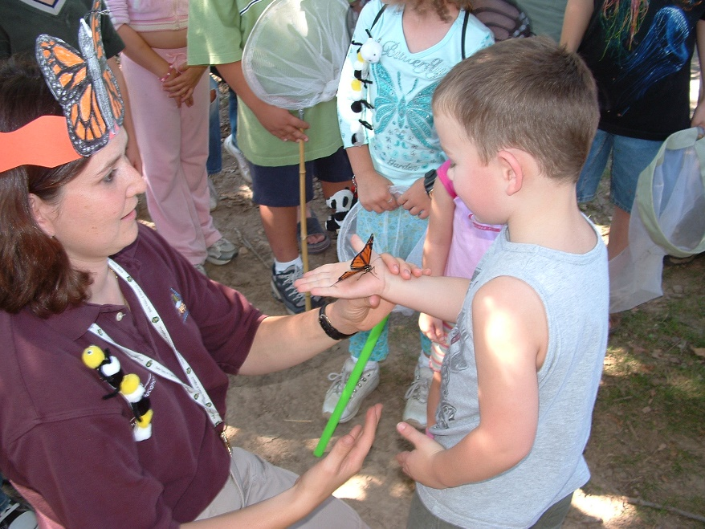
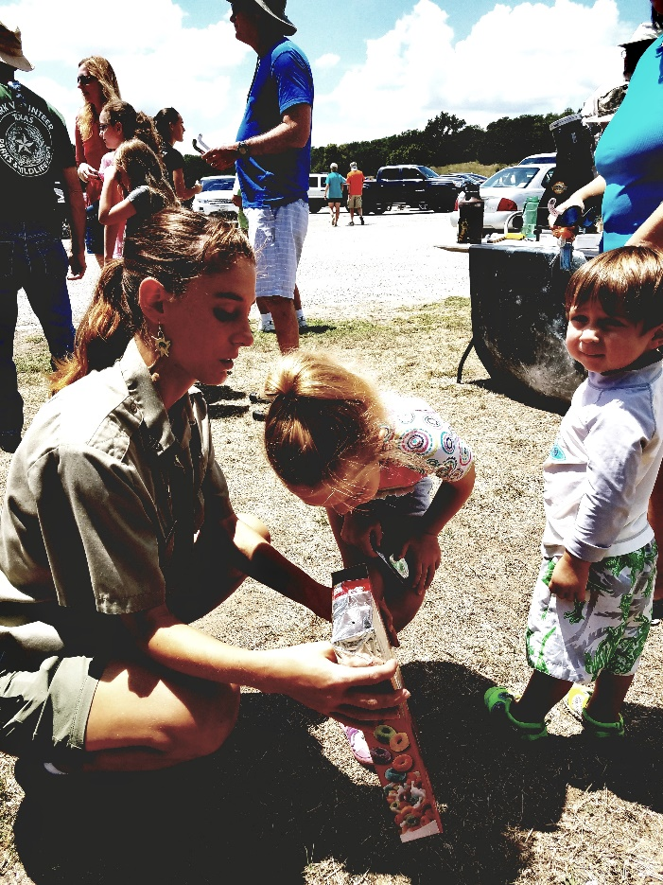
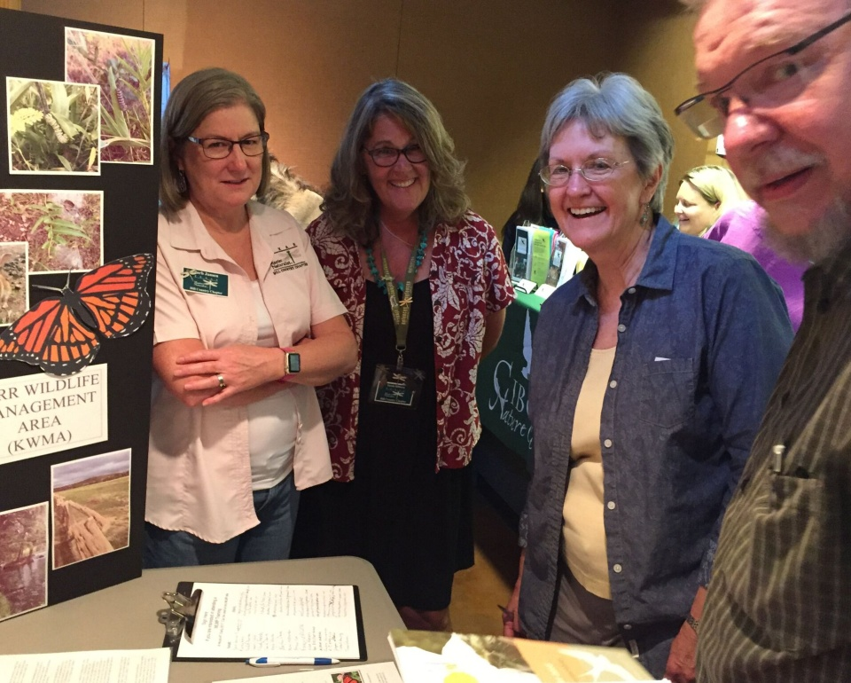
Hill Country Master Naturalists
Informal Interpretation through festivals and booths
Notes:
Non-captive Audiences

Slide 9
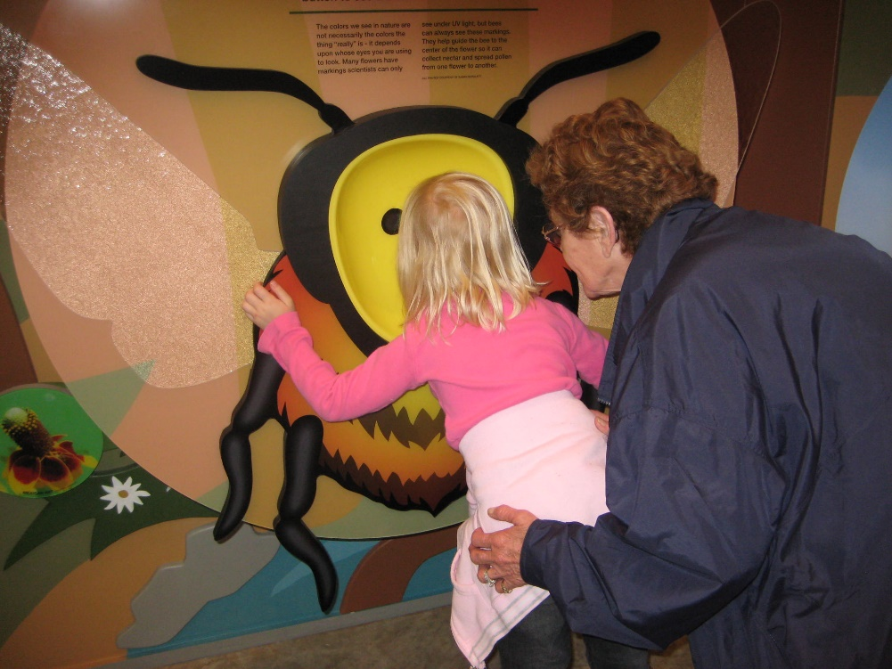
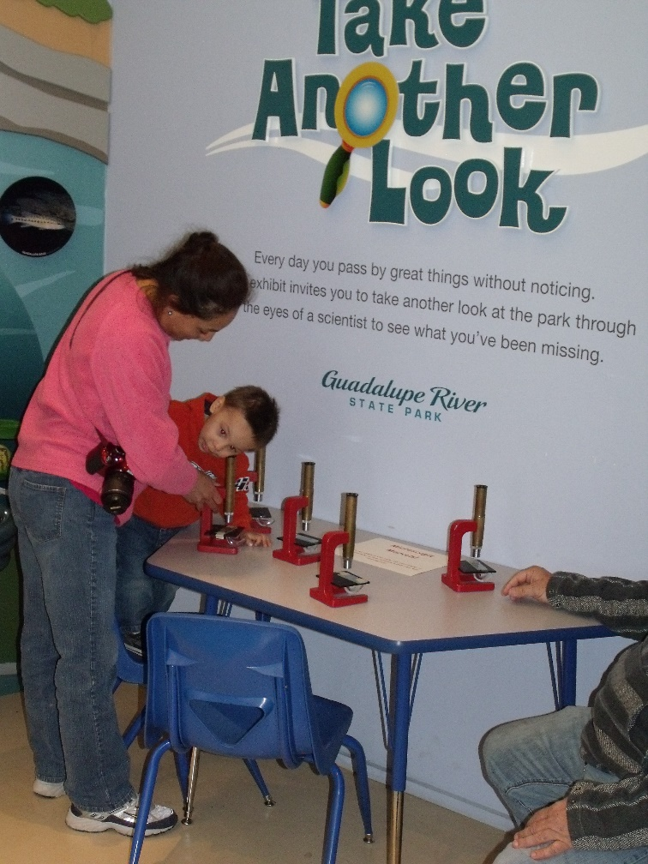
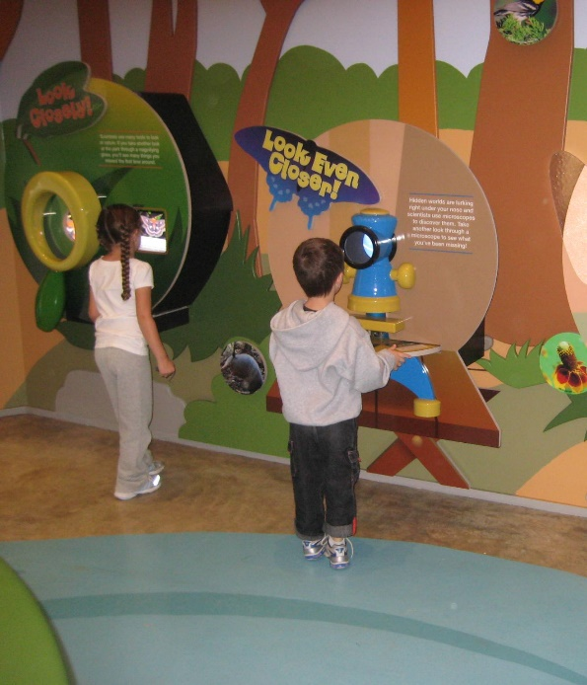
Hands-on
Interpretive
Exhibits

Slide 10
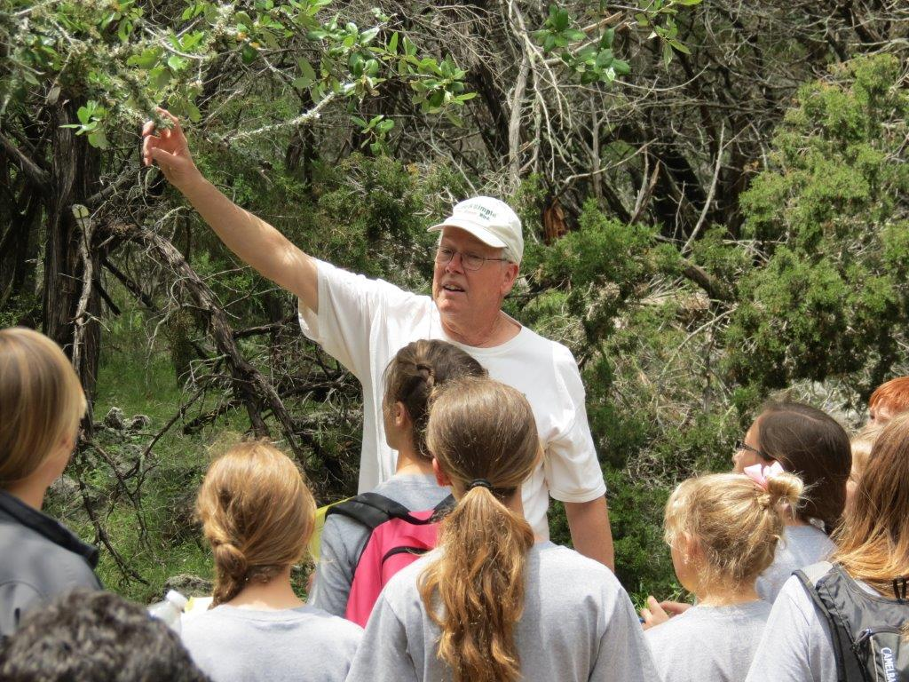
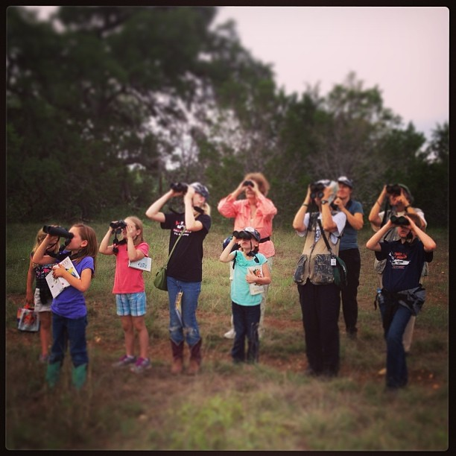
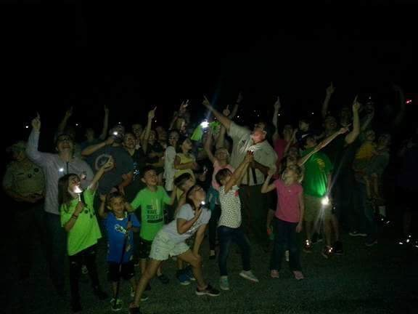
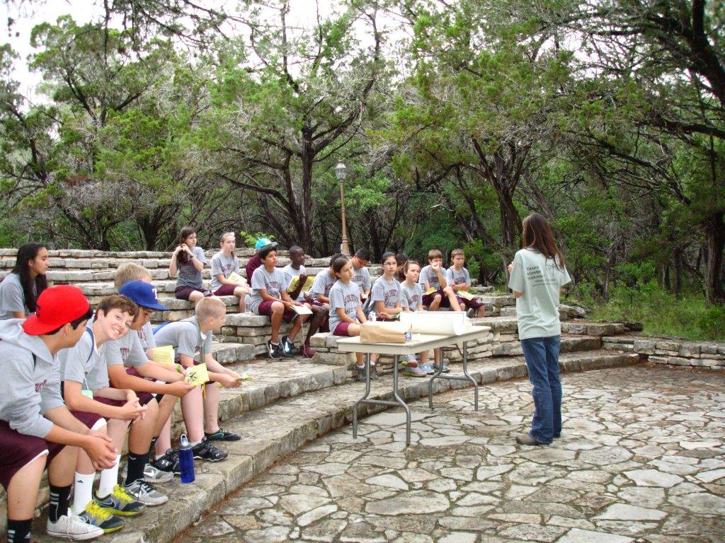
Tom Anderson, Friends of HCSNA
Guided, Formal or Non-Formal Interpretation: Personal Interpretation
Notes:
2nd question – what kinds of interpretation is your chapter engaged in?

Slide 11
Why We Engage in Interpretation
To deliver an organization’s mission and enhance visitor experiences
To share the story of the land and its people, to draw connections between this history, both cultural and natural, and the visitor – to help “root people to where they live*”
To welcome all visitors to those spaces where they can create their own connections in order that they may come to join others in developing care for, and stewardship of, those resources
*quoted from Jaime Gonzalez with Texas Nature Conservancy
Notes:
1. For TPWD, that mission states: To manage and conserve the natural resources of Texas and to provide hunting, fishing and outdoor recreation opportunities for the use and enjoyment of present and future generations.
On the second one – what this means is that we not only have to meet people where they are to interpret to them, but we must invite them in so that they can help us tell their stories/share their experiences – I can take my boxes of skins and skulls and go anywhere, but if I don’t understand where my audience is, where they are coming from, then my teaching, my interpretation with be based on my experiences – how do we break through so that we can mix my stories with my audiences stories and experiences. – share story of taking skins and skulls to day-use long ago and no one appeared interested

Slide 12
Essential Qualities of Interpretation
Thematic
Organized
Relevant
Enjoyable
Accurate
Engaging
Sensory
*T.O.R.E. from “Interpretation: Making A Difference on Purpose” by Sam Ham
Notes:
Sam Ham’s TORE model of great interpretation
Thematic – A single sentence that tells you what you will cover and what you won’t – it is a focusing statement – for example: Oak Tree is a topic, Oaks set the table for the dietary needs of predators and prey alike is more of a theme
Organized – Beginning, Middle and End – Introduction, Body, Conclusion
Relevant – information that is both meaningful and personal
Enjoyable – Pleasing to an audience to attend to and process
Accurate – factual
Engaging – people feel a personal connection to what is being interpreted – they become and stay engaged – done through artifacts and stories
Sensory – using our five senses to strengthen impact of words and concepts

Slide 13
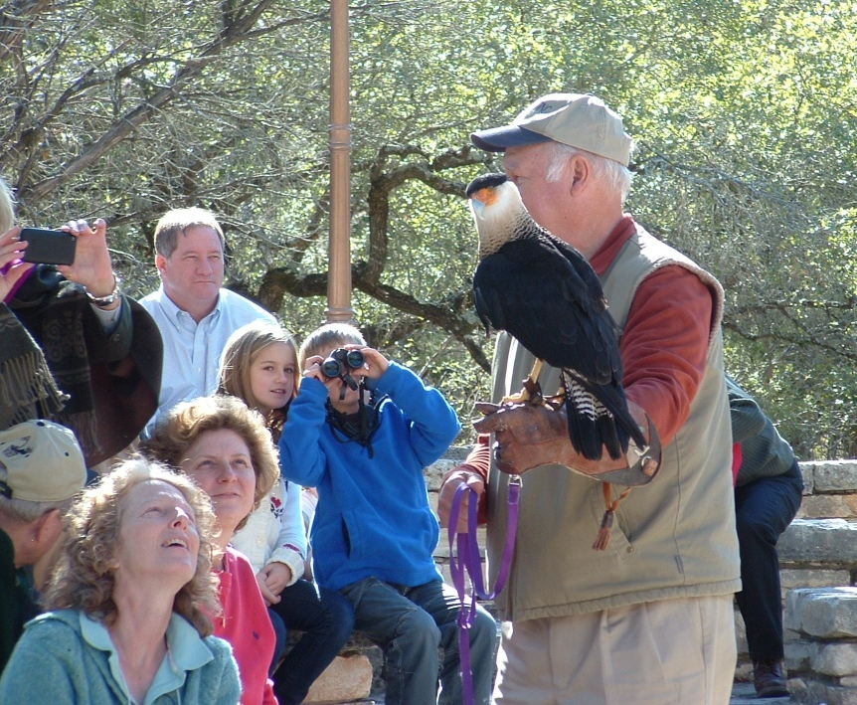
Successful Interpretation
Welcomes everyone
Presents accurate and science-based information; stays away from personal opinions
Isn’t afraid of complexity
Treats the audience as intelligent – including children
Encourages dialogue
Is in tune with audience needs whether basic comfort or learning styles
J. W. Pieper, AAMN
Notes:
Basic comfort – where is the restroom, how long is the program, what are we doing
Learning styles – understands that people take in information in different ways: auditory (hear), verbal (read), visual (see) and kinesthetic (touch/directly interact with objects)

Slide 14
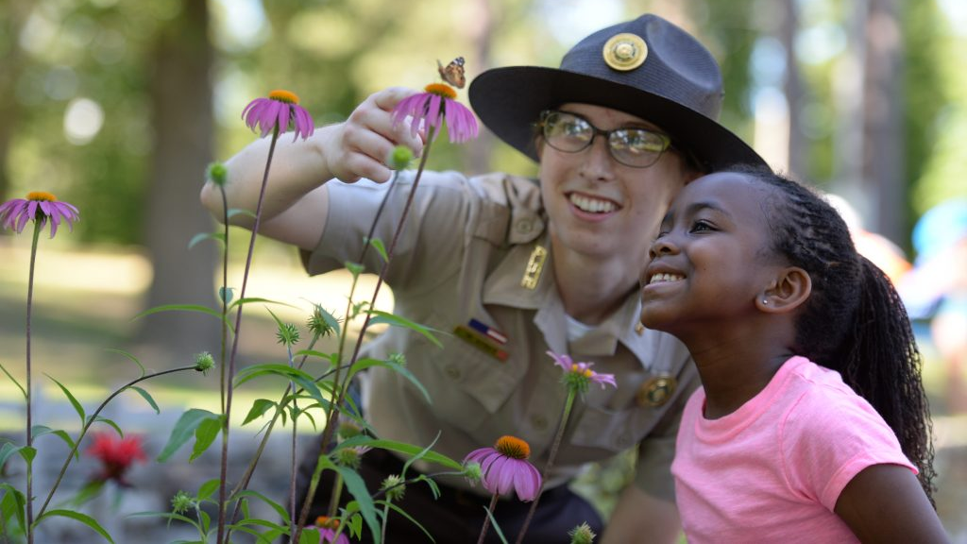
Interpretation vs. Teaching
Interpretation involves the sharing of information in a manner that invites audience engagement and wonder, leading to self-discovery of personal meaning and connection to the resource being explored
Teaching most often involves the sharing of facts for future recall – the learning and recitation of those facts is the objective
While factual information is important, it is not the end game of interpretation; it often is for teaching
The greater goal of interpretation is to communicate a message that answers the question “so what?”
Notes:
Teaching focuses on facts; Interpretation is story telling – it is intended to lead to revelation, to care, to protect,

Slide 15
NAI Definition of Interpretation
“Interpretation is a mission-based communication process that forges emotional and intellectual connections between the interests of the audience and the meanings inherent in the resource.”
Notes:
Paraphrase and discuss

Slide 16
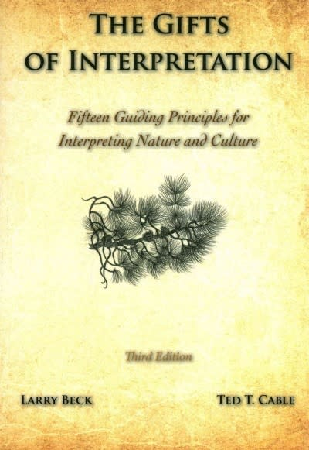
Beck & Cable’s Definition of Interpretation
“An informational and inspirational process designed to enhance understanding, appreciation, and protection of our cultural and natural legacy.”

Slide 17
David Larsen’s* Definition of Interpretation
“How to connect hearts and minds to places, objects, and other resources.”
*NPS Former Training Manager for Interpretation

Slide 18
Freeman Tilden’s Definition of Interpretation
“Interpretation is an educational activity which aims to reveal meanings and relationships through the use of original objects, by firsthand experience, and by illustrative media, rather than simply to communicate factual information.”
Notes:
Paraphrase and discuss

Slide 19
Tilden’s Six Principles
of
Interpretation

Slide 20
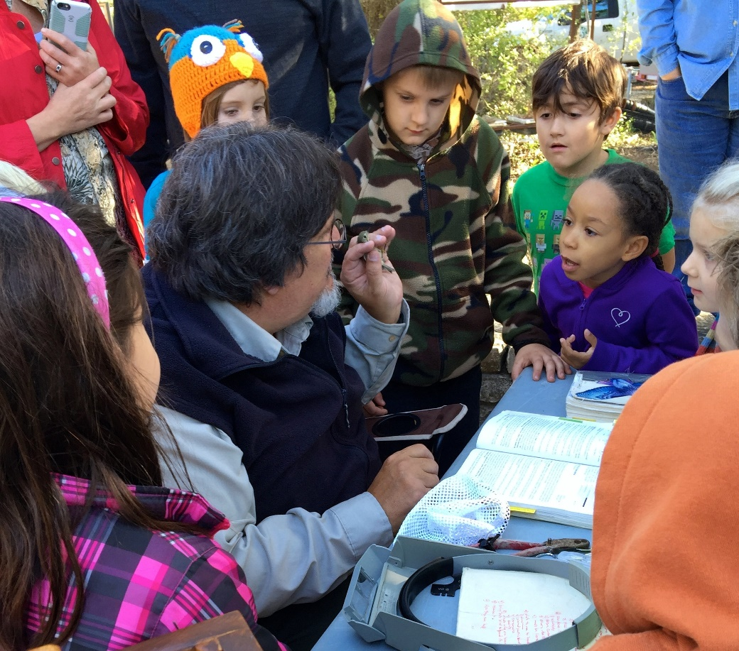
Principle one
Any interpretation that does not somehow relate what is being displayed or described to something within the personality or experience of the visitor will be sterile.
Notes:
Appeal to the visitor’s first interest – we want to spark an interest – we can do so by relating the subject to the lives of the audience – thus it is important to get to know the audience
Example – birds – ask audience how we know birds are around – song, seeing them fly, nests, feathers on the ground – birds are all around us each and every day – of all the vertebrates, birds are the ones we most likely interact with each day, whether we know it or not…
Without interest, learning will not take place and if learning is not happening, neither can revelation or caring evolve – and if this doesn’t happen, how can long-term conservation happen, either
Enthusiasm is also key – your enthusiasm reveals your interest and sparks the interest of the audience
Anatole France: “Do not try to satisfy your vanity by teaching a great many things. Awaken people’s curiosity. It is enough to open minds; do not overload them. Put there just a spark. If there is some good flammable stuff, it will catch fire.”

Slide 21
Principle Two
Information, as such, is not interpretation. Interpretation is revelation based upon information.
When I Heard the Learn’d Astronomer
by Walt Whitman
When I heard the learn’d astronomer,
when the proofs, the figures,
where ranged in columns before me,
when I was shown the charts and diagrams,
to add, divide, and measure them,
Till rising and gliding out I wandered off by myself,
In the mystical moist night air, and from time to time,
Looked up in perfect silence at the stars.
When I sitting heard the astronomer where he lectured with much applause in the lecture room,
How soon unaccountable I became tired and sick,
Notes:
Information is the raw material of interpretation
We must find ways to reveal information in meaningful ways providing the audience with new ways to look at things – discover new meanings
Need to tie together the tangibles with the intangibles – use the “things” to reveal the meanings
This is where personal experience with and within the resource lends itself to us being able to reveal the specialness of the site or resource
This also means we must do our research – we must be accurate
Done correctly, we can lead visitors to “ah-ha” moments

Slide 22
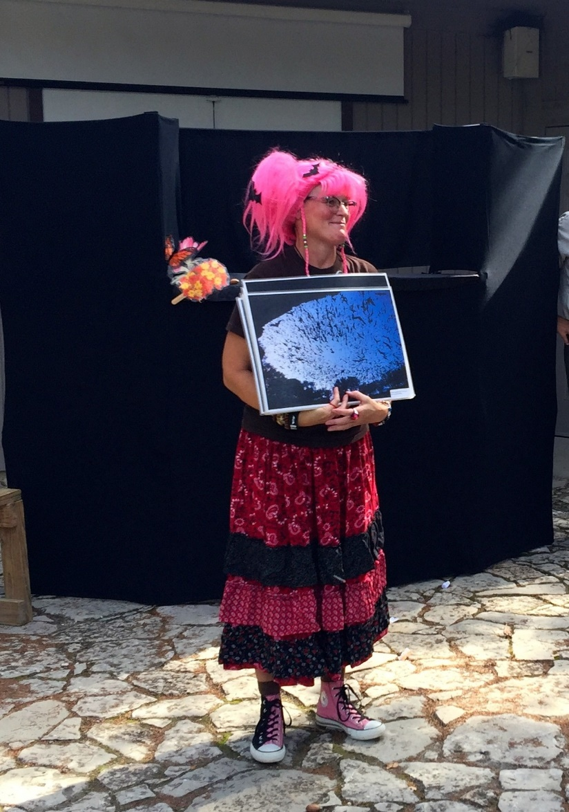
Principle Three
Interpretation is an art, which combines many arts, whether the materials presented are scientific, historical, or architectural. Any art is to some degree teachable.
“A nature guide is an artist”…Enos Mills
Nyta Brown, TPWD
Notes:
The story’s the thing; we must use our skills and creativity to tell the story of the site
Storytelling is a powerful tool to draw people in, to connect them emotionally, to reveal the “biography of the place” – Enos Mills
Could include a game like Bat and Moth, a song, puppet shows – yes it is entertainment but all can teach and be interpretive with effort and not just be something to be something

Slide 23
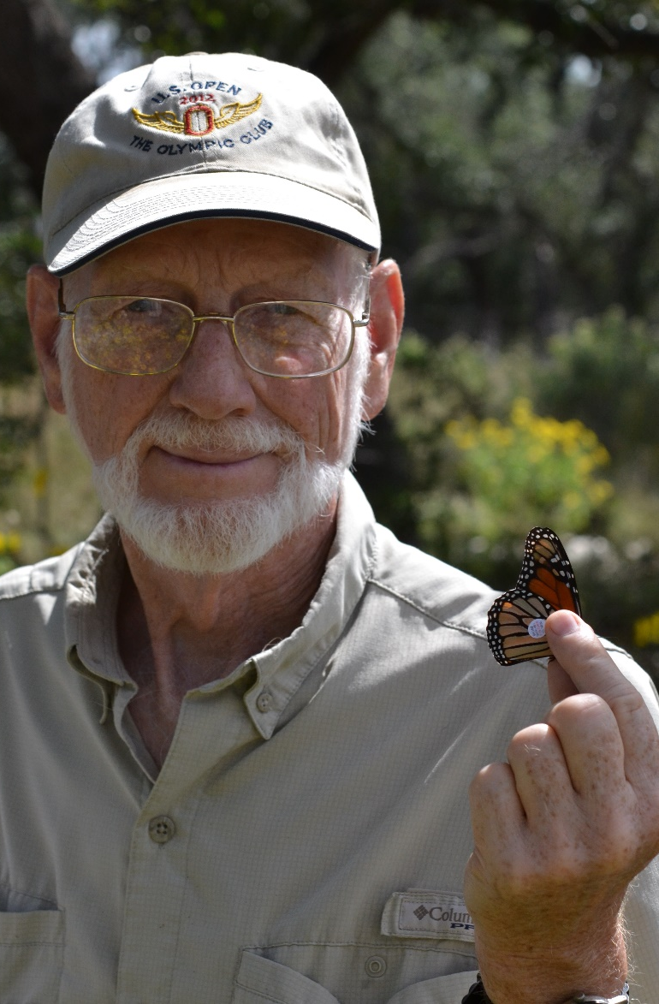
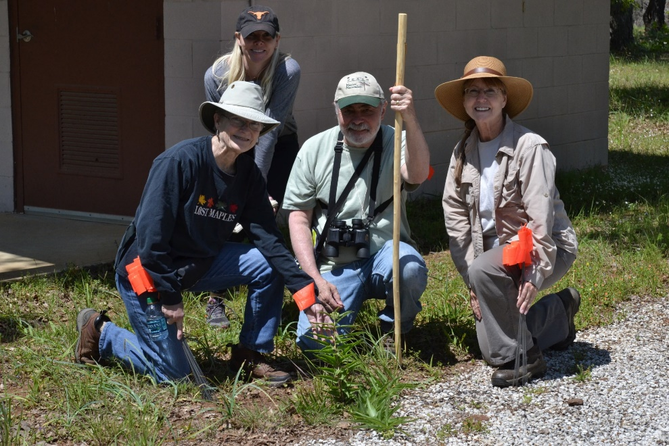
Principle Four
The chief aim of interpretation is not instruction, but provocation.
Laird Ingham, LMN
Guadalupe Chapter MNs
Notes:
Through interpretation, understanding, through understanding, appreciation, through appreciation, protection – to grow conservationists, we must generate interest and long-term engagement with the natural world on an individual level
Beck and Cable: The purpose of the interpretive story is to inspire and to provoke people to broaden their horizons.
Leading by Example: The interpreter’s passion and demeanor and love of the resource is provocative – these entice the visitor to emulate the interpreter, hold their attention, cause them to want to look into it further and perhaps care as much
Orientation: many visitors don’t know much about the resource and thus may miss the point – we need to find ways to encourage them to explore to discover
We must help the visitor see themselves in the place just as they see themselves in their home – if they care about their home, how can we translate that to caring about the resource they are visiting – if it becomes a part of them then perhaps they will become respectful of the place – they will value it and want to protect it.

Slide 24
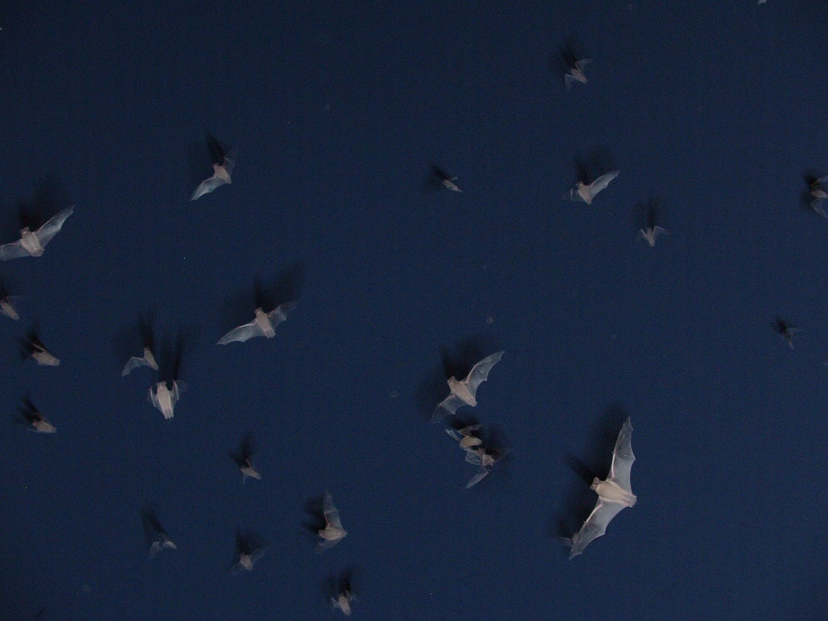
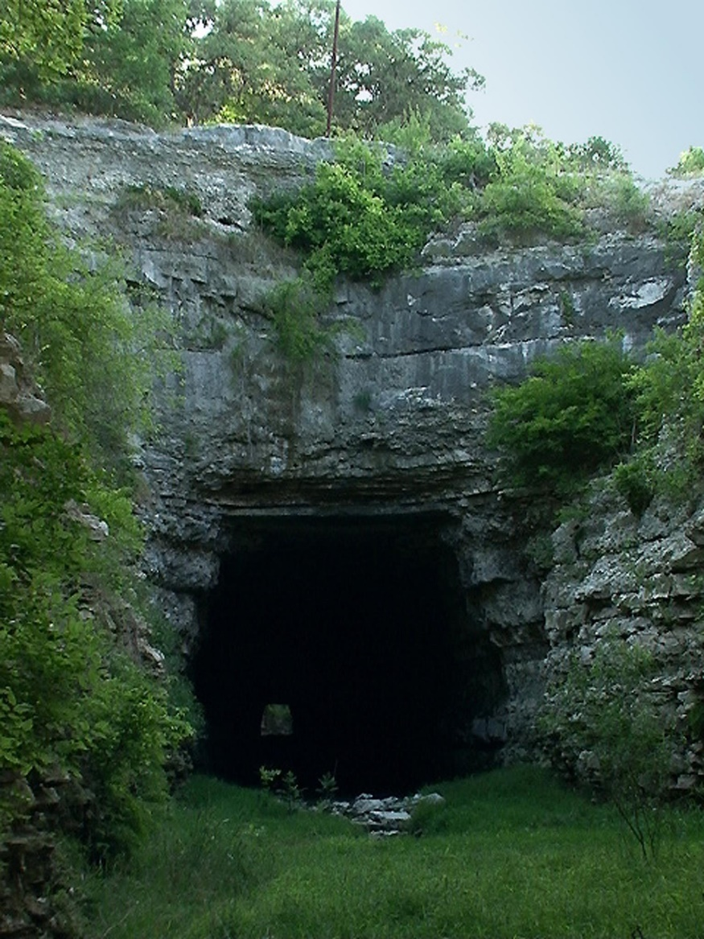
Principle Five
Interpretation should aim to present a whole rather than a part and must address itself to the whole man rather than any phase.
Notes:
Wisdom is not a knowledge of many things but the perception of the underlying unity of seemingly unrelated facts
Whole does not mean every detail of every little thing that ever happened, that is impossible; rather, it should be a focused whole (Beck and Cable) – this is where theme-based interpretation (TORE) comes in – at Old Tunnel SP there are multiple stories – land use, the tunnel for the railroad, the history of the railroad and people’s use of it, what happened to the tracks after the trains stopped passing through to today’s story of the bats that use the tunnel – how those stories are told can present a whole without blitzing people with every fact – it is a conscience decision on what aspects of the many stories are to be told;
Whole in terms of the people means we need to understand the needs of the people that come to the resource – includes basic needs such as water and restrooms (comfort), understanding of underlying fears (afraid of the dark, will the bats land on me and bite me giving me rabies, etc); sense of community or belonging (being welcoming and thank them for attending); sensory – sights, smells, sounds – engaging the senses as they are powerful reminders of the experience.

Slide 25
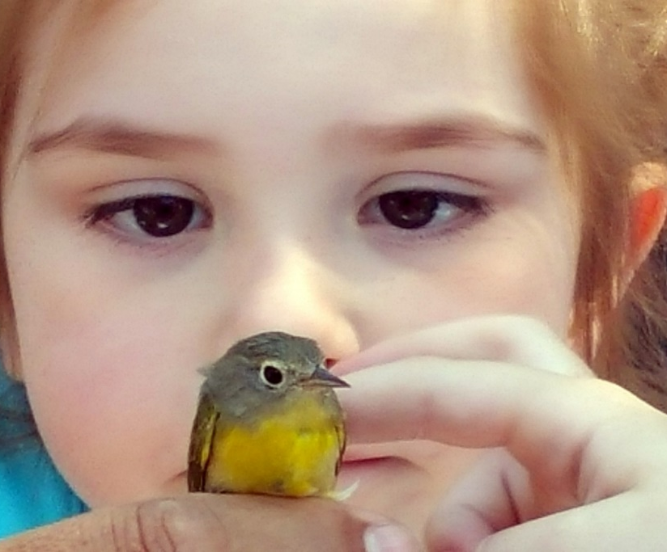
Principle Six
Interpretation addressed
to children should not be
a dilution of the
presentation to adults,
but should follow a
fundamentally
different approach.
“If I had influence with the good fairy who is supposed to preside over the christening of all children I should ask that her gift to each child in the world be a sense of wonder so indestructible that it would last throughout life…” -Rachel Carson
Notes:
You cannot “water down” a program for adults to make it fit children; children have different needs, different attention spans, different interests.
Children see the world from a different level than adults do; children are also incredibly capable to picking up on things; they will surprise, even shock, you with what they already know.
They are inquisitive, excited, excitable and have a sense of wonder we must nurture!

Slide 26
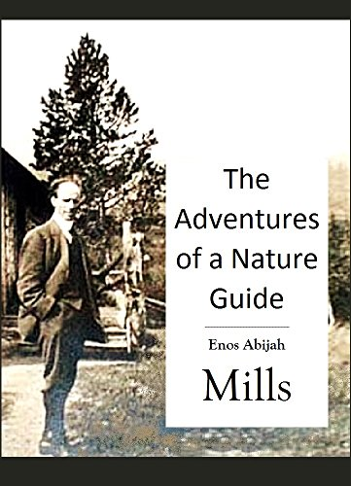
The Interpreter
“The interpreter arouses interest by dealing in big principles – not with detached and colorless information. He creates more permanent interest in the biography of a single tree than in the naming of many trees.”
“The best interpretation comes from the heart and is laced with imagination, creativity, inspiration, revelation, and personal commitment.”
Notes:
One of the earliest people to talk about interpretation was Enos Mills – his writings resonate to this day…
Biography – immerse yourself in that tree or that critter – naming things for naming things – people most likely won’t remember that
Example – Live Oak – my wife Terry Lashley told me of a volunteer describing the branches of a live oak resting as its “elbows” on the ground – what a great way to remember what a large live oak looks like versus another tree…

Slide 27
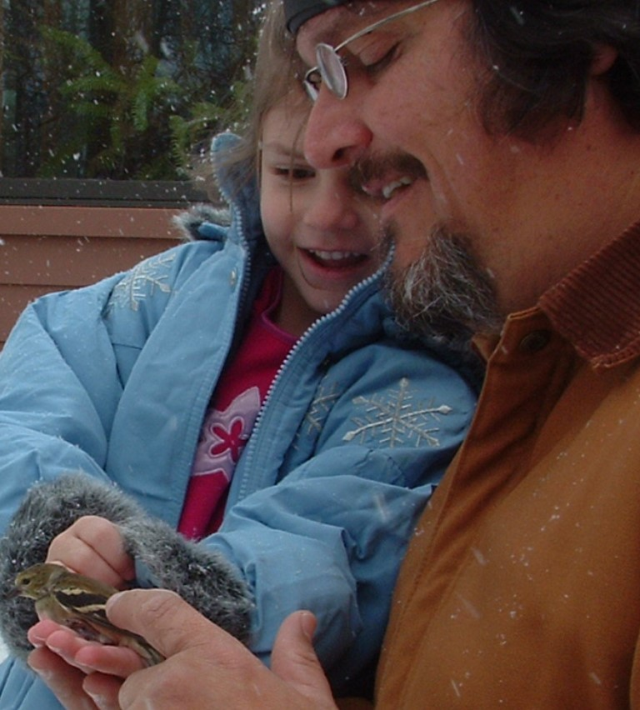
“Before you can inspire with emotion, you must be swamped with it yourself. Before you can move their tears, your own must flow. To convince them, you must yourself believe."
-Winston Churchill

Slide 28
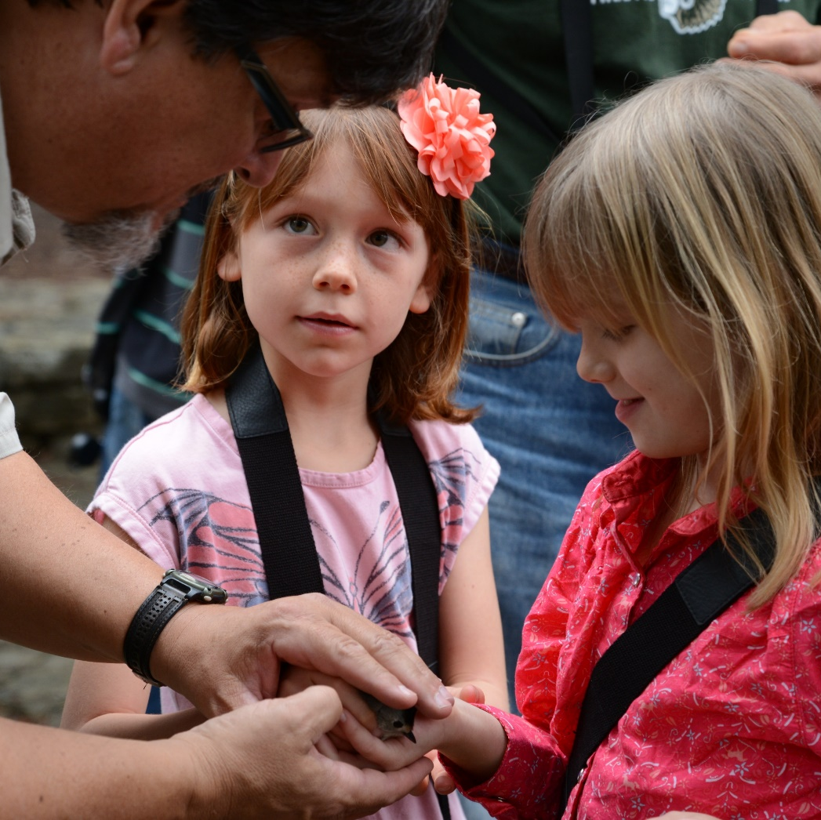
What Makes an Interpreter
You Should:
Being organized and ready to present
Having a strong sense of wonder
Being genuine
Having a passion for, and knowledge of, the resource
Being a weaver of stories, an artist
Being a life-long learner – about nature, about interpretation, about people
In a word…caring
“The people-to-people connection is what drives the people-to-nature connection”
-Taiji Nelson, Pittsburgh Parks Conservancy

Slide 29
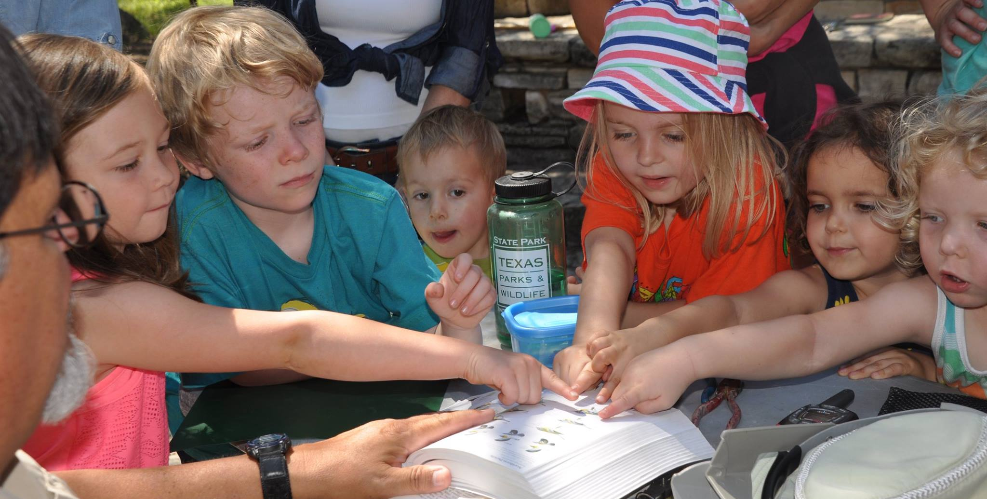
What Makes an Interpreter
For Your Audience:
Being on-time
Being welcoming
Addressing basic comfort of the audience
Understanding interests of the audience
Being adaptable – teachable moments, weather changes
Being open to changing your program objectives as your audience needs change
Having a passion for people of all backgrounds and experiences – and an openness to learning about them and their experiences
Thanking your audience
Being open to accepting thanks

Slide 30
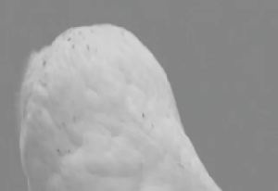
Let’s Get Practical…
You don’t have to know everything – and you won’t and don’t, anyway, i.e. it is okay to say “I don’t know”
That said, study, but mostly, spend time in and with the resource – books are great but the resource is the real place for the most learning
Expect the unexpected – i.e. use “teachable moments” when they appear
By the fact you are interested and sharing this interest puts you ahead of your audience – don’t freak out
Depending upon your topic in the field, take a field guide or whatever other supplement that helps
Walk the path before you walk the path with your audience
Be genuinely amazed

Slide 31
When all else fails, remember these basics

Slide 32
Every age matters
Notes:
Too many times I hear from Master Naturalists that they don’t like working with young children; what a mistake! Our youngest ones are the very children that we must engage at an early age – without them becoming part of the natural world at the youngest ages when they are sponges, most curious and asking questions, we lose them – we just do. At the same time we need to engage middle school and high school students as well. Most EE is delivered to elementary age students – for many it is already too late; but for some it is like they are thinking “why haven’t I done this more often?”

Slide 33
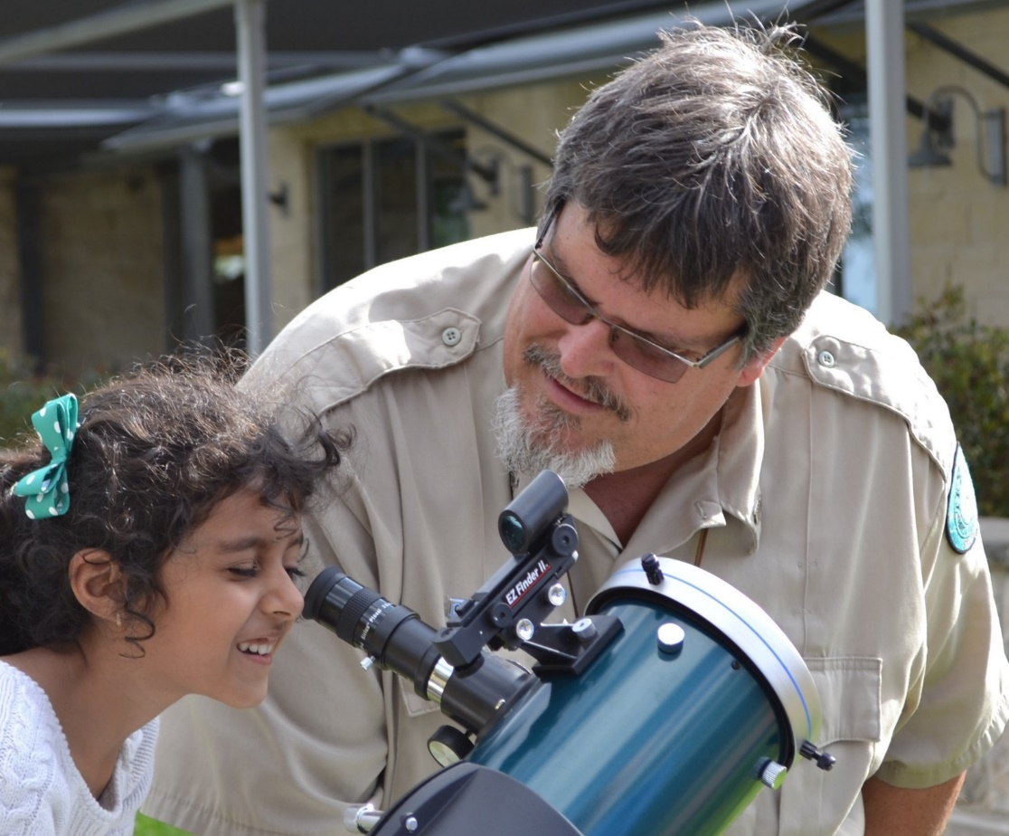
Engage with them
Be in the
moment with them
Notes:
Be a part of the activity, don’t only direct the activity but join them for better or sometimes seemingly worse; when they see you are “in to it” they will be in to it; when you stand back or are reserved they will reflect your behavior.

Slide 34
Explore with them outside
Get
on
their
level
Notes:
1st of all, actually get them outdoors; don’t talk about the outdoors but put them in that setting. If you only talk about nature it is dry and it will not connect them. In addition, it must be multiple times; one field experience as a fifth grader is good in the moment but it is through repeated experiences with Nature that real connections are made – and real experiences that carry on for potentially a lifetime. Modeling behavior – per Tania – also adapting based on audience reaction.

Slide 35
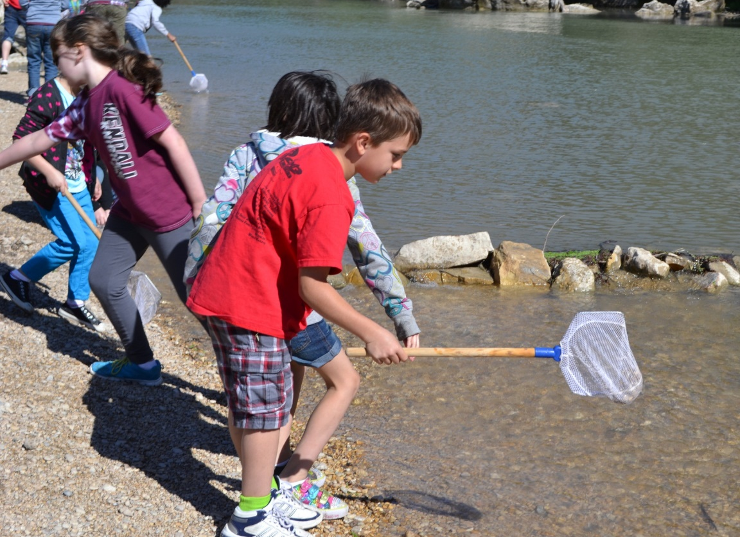
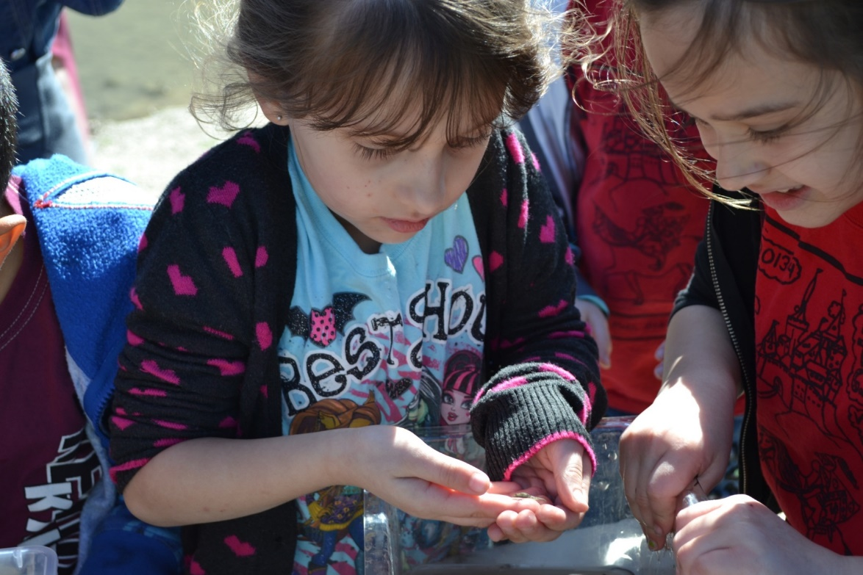
Doing matters
Hands on…Hands in
“If facts are the seeds that later produce knowledge and wisdom, then the emotions and impressions of the senses are the fertile soil in which the seeds must grow.” -- Rachel Carson
Notes:
I often say that its about the process not the product. What I mean is that they will far longer remember what they experienced with Nature than the facts that you proudly imparted on them. A little controlled chaos is okay – it means that they are in fact into it.

Slide 36
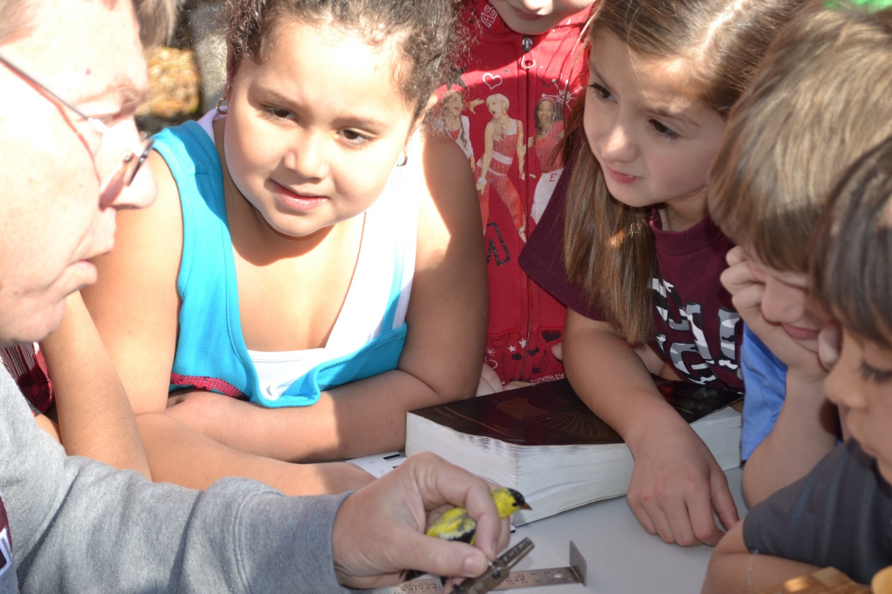
Cliff Hendrick
Talk with them, not at them
Notes:
We must have a conversation, not just instruction; by addressing them each as individuals, as people, you will find more engagement; be sincere; treat them with the same respect you would an adult – children are people, too.

Slide 37
Provide the tools for self-discovery
Use real items
Notes:
Science and nature are best done with magnifiers, microscopes, binoculars – the same things we use as adults we should afford to the children – might you lose a magnifier, might something fall to the floor --- yep, but the process matters, the exposure matters.

Slide 38
Let them figure it out – and they will!
Notes:
Children have lots to share and will amaze you with what they know – parents are stunned all the time with answers children give at presentations – empower them to do so.

Slide 39
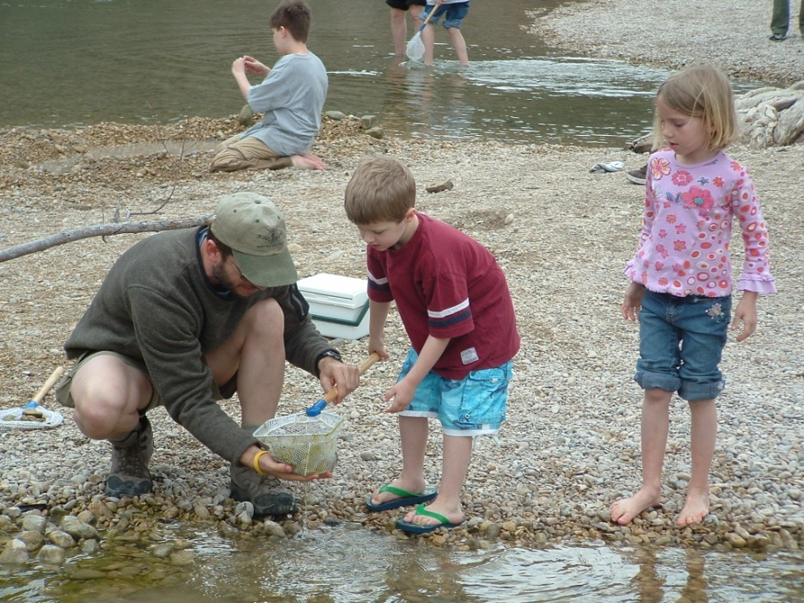
Engage their parents, too
Notes:
Don’t let the parents stand in the back and talk about the weekend, get them working with their children – you will be with the children for a short while, we need to engage the parents so they will carry what you do beyond that hour, that day – engage them, get them excited and you are strengthening the bond between parent and child and giving the child a different view of their parent and the parent a new view of their children.

Slide 40
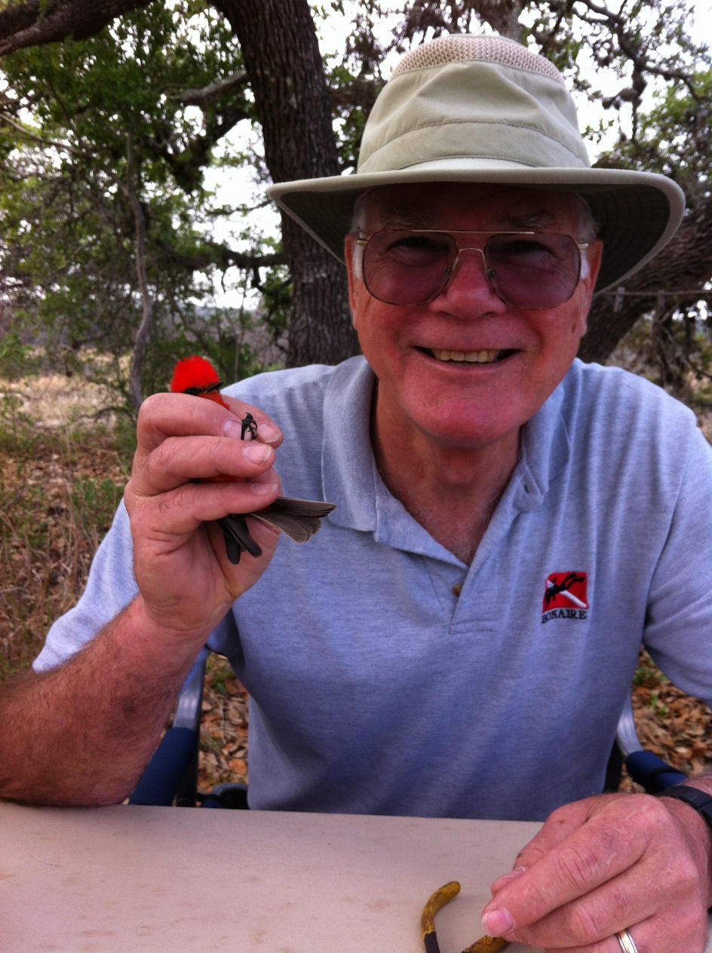
Rediscover Your Sense of Wonder
Have FUN!
John Prentice, AAMN

Slide 41
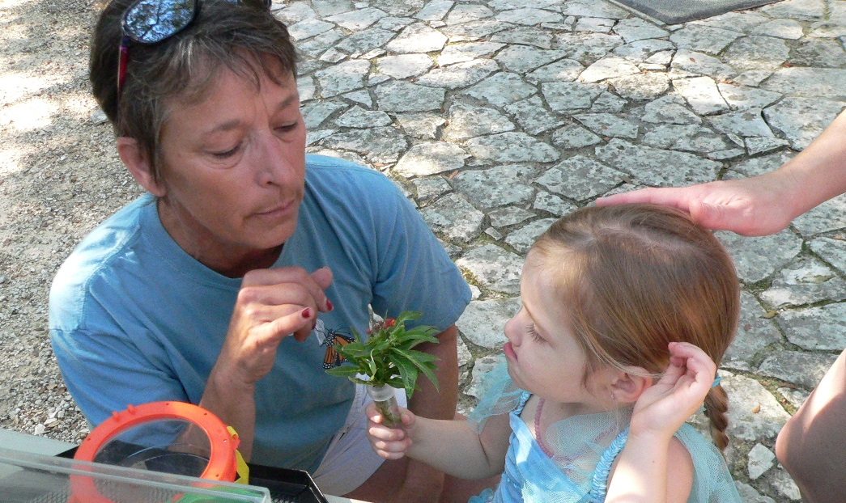
The Gift of Passion
Passion is the essential ingredient for powerful and effective interpretation – passion for the resource and for those people who come to be inspired by the same.
- Beck and Cable
Cathy Downs, HCMN

Slide 42
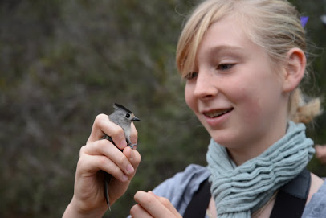
The Priceless Ingredient
If you love the thing you interpret, and love the people who come to enjoy it, you need commit nothing to memory. For, if you love the thing, you not only have taken the pains to understand it to the limit of your capacity, but you also feel its special beauty in the general richness of life’s beauty.”
“. . . the six principles with which I began this book may be after all…a single principle.
If this should be so, I feel certain
that the single principle must
be . . . love.”
- Freeman Tilden

Slide 43
So what?
Does any of this really matter?

Slide 44
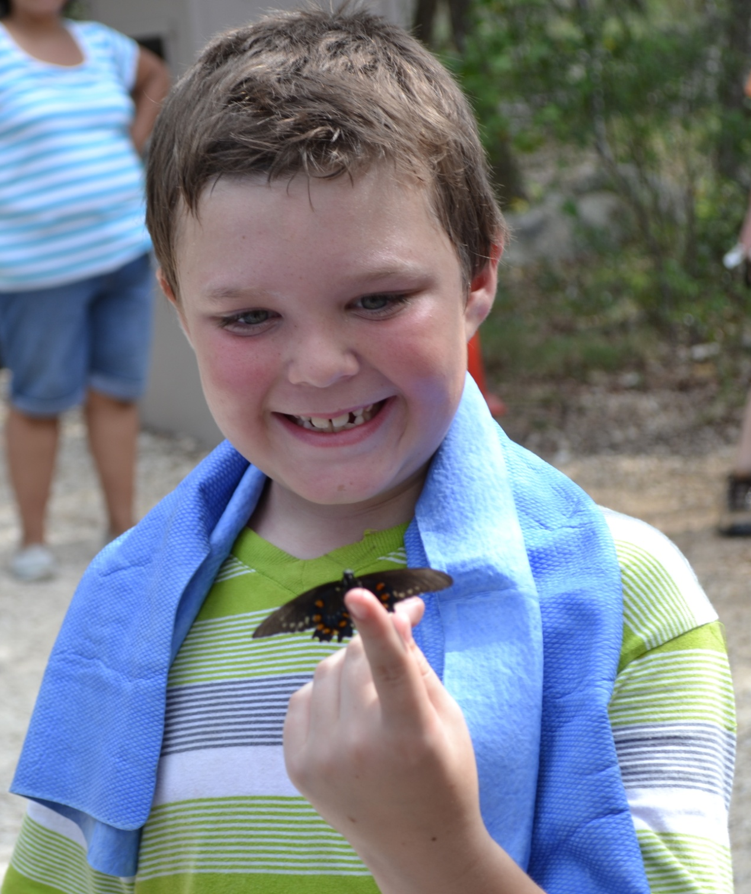

Slide 46
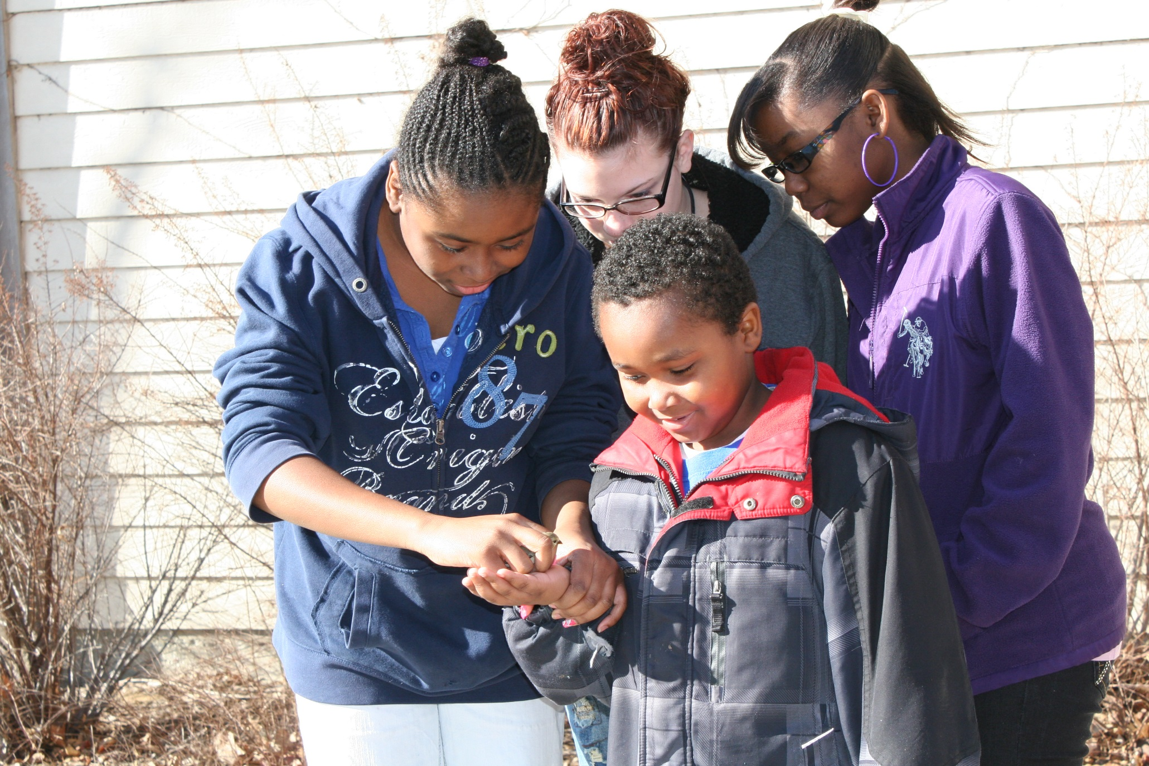

Slide 47
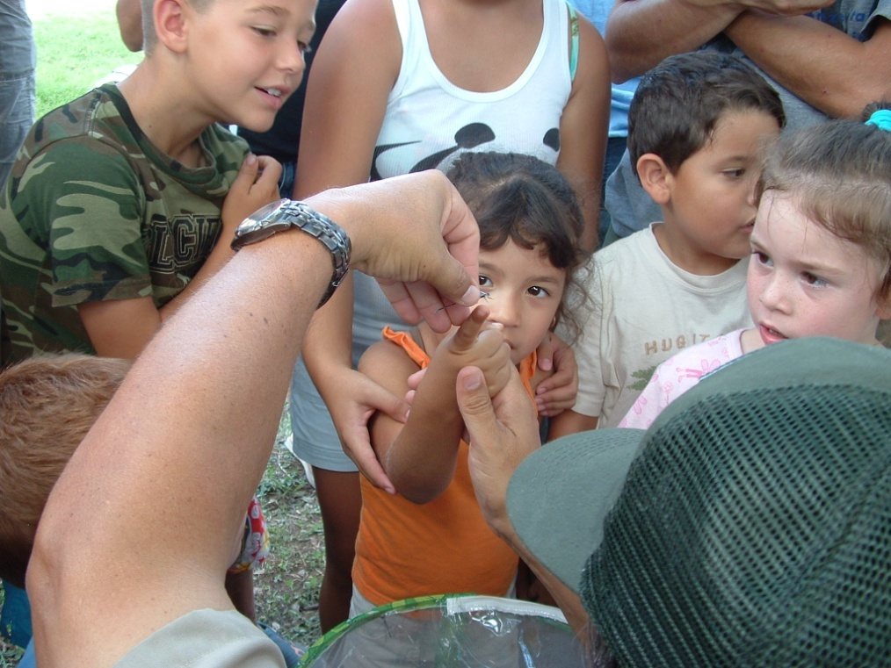

Slide 48
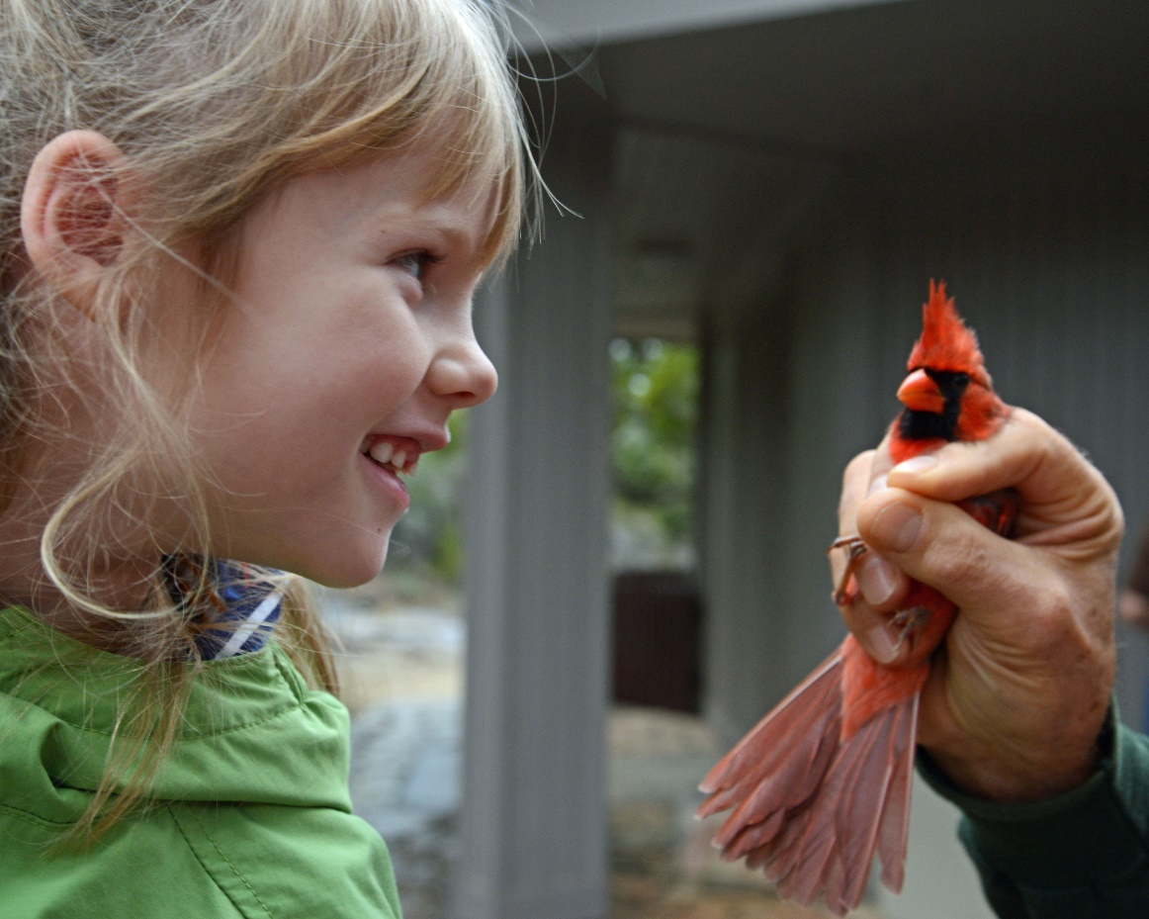
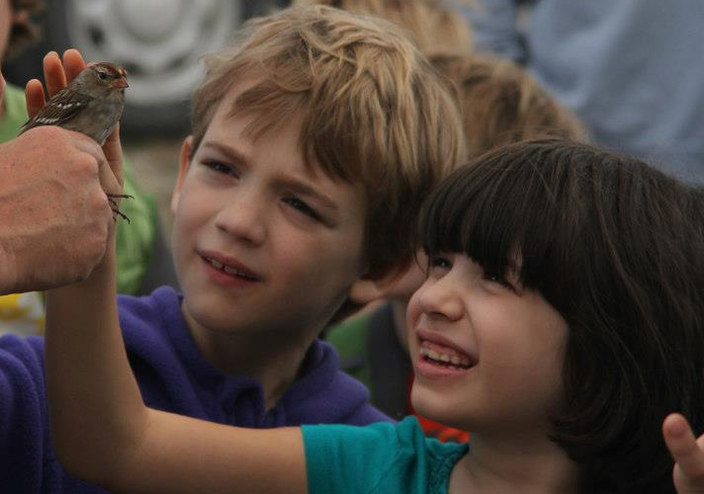

Slide 49
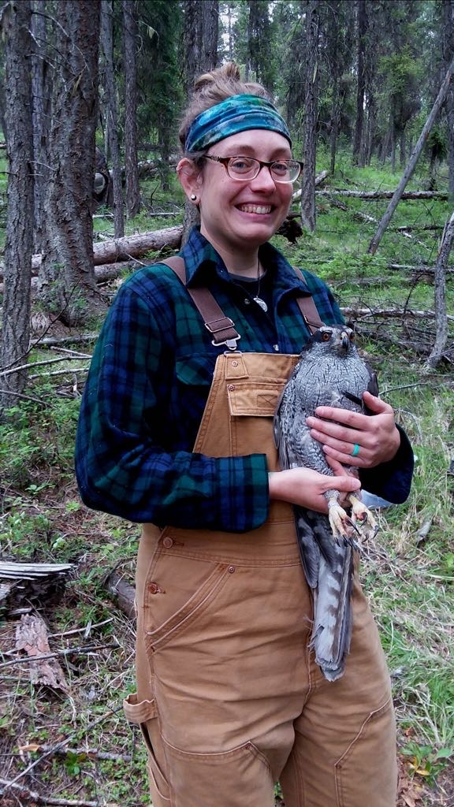
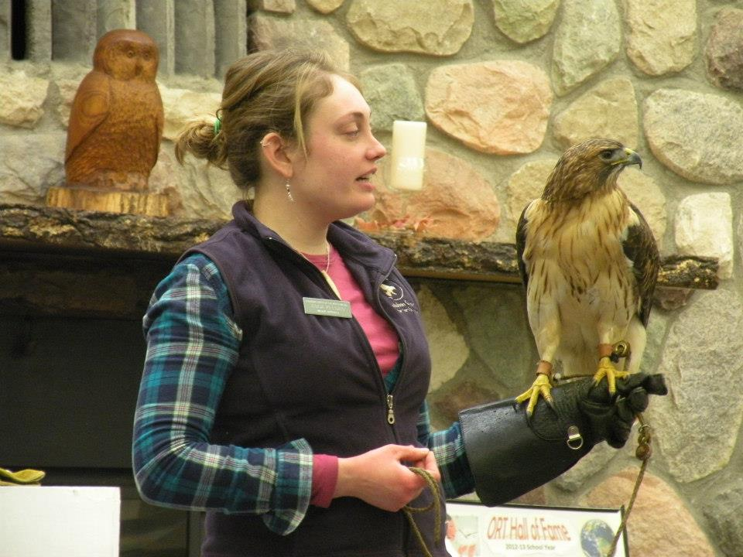
Anna Keenan
Notes:
Anna Keenan – first when she was 10 or 11, became an interpretive naturalist/firefighter and biologist, and now a mom now an assistant forester with Nebraska Forest Service

Slide 50
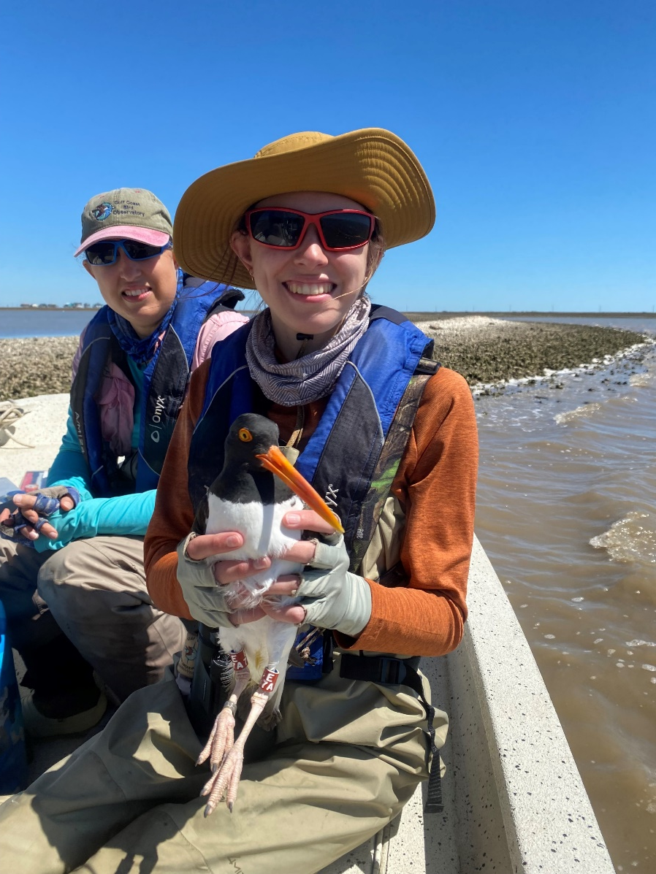
Kenlynn Volz
Notes:
Kenlynn Volz – bird banding, education, just completed degree, research internship on oystercatchers and other birds at Gulf Coast Bird Observatory, just accepted to graduate school at UT Tyler to study snake fungal disease in snakes combining population genetics with ecological niche modeling, whatever that is :0)

Slide 51
“Back in 2006 or thereabouts, we attended a bird-banding event run by you at the Martha Lafite Thompson Nature Sanctuary in Liberty, MO. My daughter was only 6 or 7 years old at the time. You allowed her to “release” a goldfinch after it had been banded. I thought I would give you an update on what has happened since that day.”
“When we trace back my daughter’s interest in birds, (more like an obsession now) we are pretty sure it began with that first bird-banding event with you. Birds have been her passion ever since!”
- Shari Mutchler
Notes:
Marky has now graduated from Louisiana State University and is now a Research Technician at the Moore Lab of Zoology and Genomics Center.

Slide 52
So, yes, I KNOW it matters
This means what you do when working with scouts matters, each and every time.
You are an influencer for the environment, a changer of lives and a conduit between the natural world and society.
This is a powerful space you occupy –
share your passion and wield it with care and compassion.
You may never know when your passion for, and commitment to, the natural world will indeed make a difference in the life of another person, but I invite you, I implore you, to take the chance – I believe – I know – it will.

Slide 53
Challenges for Interpretation and Interpreters
We must remember that people enjoy the outdoors differently – thus we must consider that how we prefer to enjoy the outdoors may be different than others – and thus we must recognize, accept, and adapt to those differences
We must find ways to engage children that don’t already spend time in the outdoors – we must consider taking our work to them, to their spaces
In the case of children, we must find ways to get away from one-and-done field trips; we need to extend field experiences through multiple grade levels over time, and leverage the experiences of children to engage families, and if possible, whole neighborhoods or communities
Notes:
That said, we can address these things by…

Slide 54
Lend Your Hand, Create a Spark
“Get in there and care” -Kyle Reid, University of CA Santa Cruz
Notes:
It is up to us – it really is.

Slide 55
To learn more about Interpretation:
National Association for Interpretation: https://www.interpnet.com/
North American Association for Interpretation: https://naaee.org/
Interpreting Our Heritage by Freeman Tilden
Interpreting for Park Visitors by William J. Lewis
Interpretation: Making a Difference on Purpose by Sam Ham
The Gifts of Interpretation: Fifteen Guiding Principles for Interpreting Nature and Culture by Larry Beck and Ted T. Cable
Beyond EcoPhobia: Reclaiming the Heart in Nature Education by David Sobel
Reaching for Connections Vols 1 & 2 by David W. Stokes
Sharing Nature with Children (and volume 2) by Joseph Cornell

Slide 56
National Association for Interpretation
Training Opportunities

Slide 57
Questions for Consideration
When working with scouts, could you see the value of utilizing the principles of interpretation, or are you satisfied with “just” teaching?
Scouting attempts to teach life skills, does it include appreciation and respect for the natural world?
Does your work with scouts lead to advocates for the natural world or simply consumers of its resources and earners of merit badges?
Is there value in training scout leaders on the principles of interpretation or having staff certified in interpretation?

Slide 58
Thank you
craig.hensley@tpwd.texas.gov

